Slide 1
Go-Chat
1570348 Park, Woo Min
1604674 Li, Yiqi
1655556 Chen, Wenwen
1561297 Chen, Jing
1611211 Chen, Huiping
1669396 Muawwanah, Anisaul

Slide 2
Outline
Introduction
Aims and Strategy
Time table
Initial Progress
Project Organization

Slide 3



Introduction
Server
Web Client
Windows client

Slide 4
Aims and Strategy
Aim: Reliable, Secure, Attractive
Level 1 Basic Functionalities
Level 2 Security
Level 3 Other Additional Functionalities

Slide 5
Level 1. Basic Functionalities
Client 1 sends message to server, client 2 receive the message from the server which from the client 1. If the message is not a plain text, client 2 send a request to the server to receive data.
Client1
Server
Client2
2. Send message
1. Send message
3. Send request
4. Send data

Slide 6
Level 1. Basic Functionalities
Sever
Database :MYSQL
Web server :Apache
Client
Web :PHP
Windows application :C#
Protocol: WebSocket

Slide 7
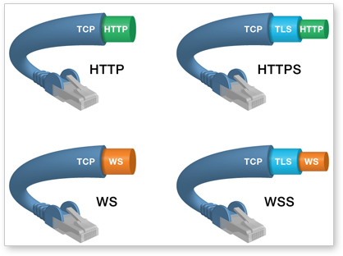
Level 2. Security
<WebSocket over TLS>

Slide 8

Level 2. Security
Hash function + Salts
ID, Password
Encryption Algorithm
<Database security>

Slide 9







Level 3. Other Additional Functionalities

Slide 10
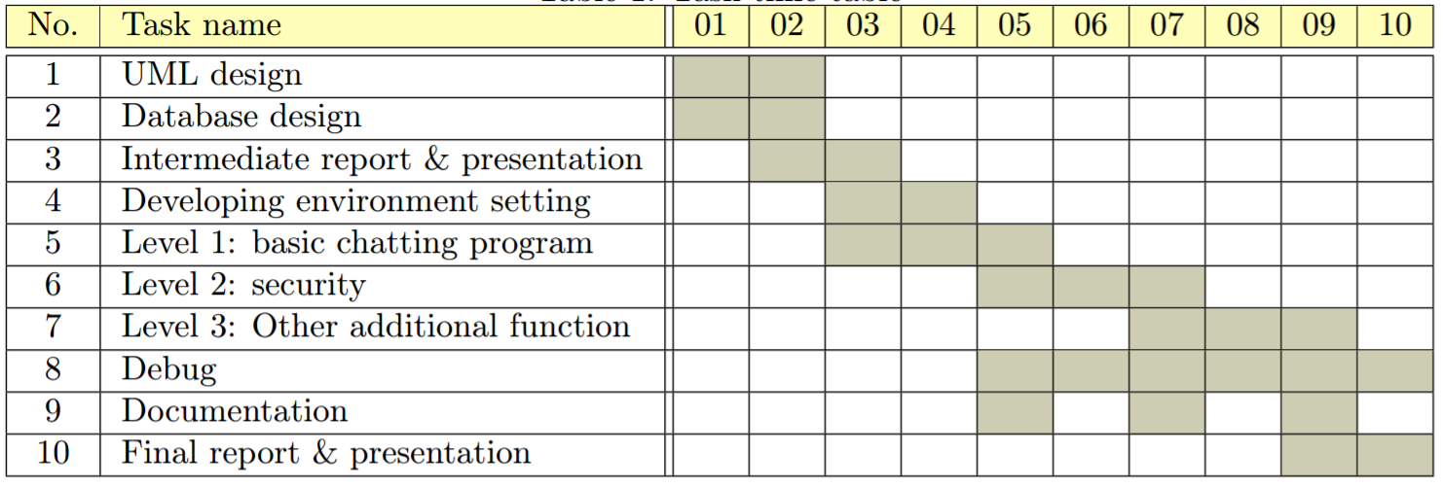
Time table

Slide 11
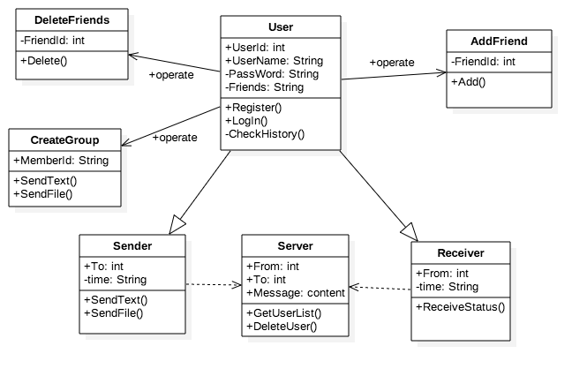
Initial Progress
<UML Class Diagram>

Slide 12
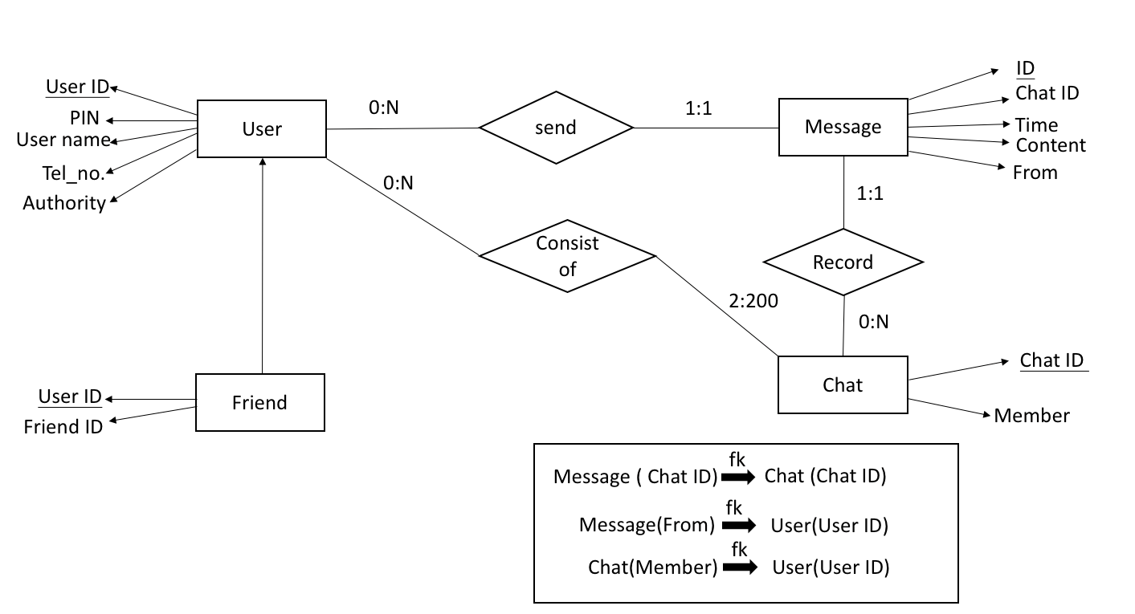
Initial Progress
<ER model>

Slide 13
Project Organization
To collaborate with each other
Weekly meeting :Guy’s campus library
Whatsapp
Github
LaTex :overleaf
Team1 | Park, Woo Min | Chen, Wenwen | Muawwanah, Anisaul
Team2 | Chen, Huiping | Chen, Jing | Li, Yiqi

Slide 14
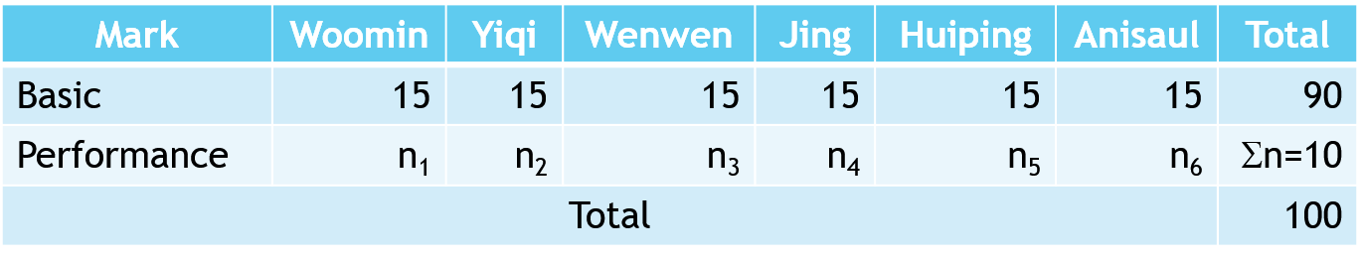
Project Organization
Peer Assessment
Conflict Handling
Discuss possible solutions
Choose the best solution (advantages & disadvantages)

